Slide 1
Power BI Dashboard Insights: USA - Car Sales Analysis

Slide 2
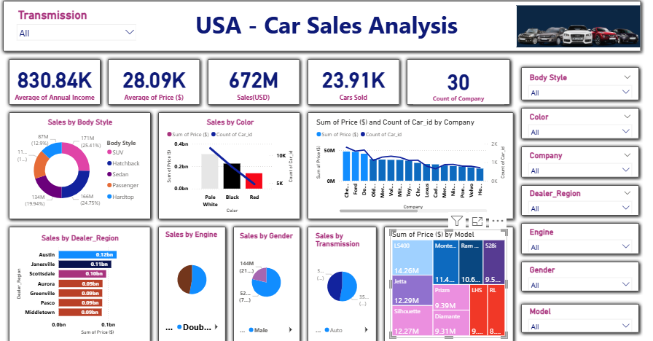
Dashboard Overview Title: USA - Car Sales Analysis
Key Metrics Displayed:
Average Annual Income: 830.84K
Average Price ($): 28.09K
Total Sales (USD): 672M
Cars Sold: 23.91K
Count of Company: 30
Insight: Strong car sales volume and revenue with
mid-range pricing and high-income customers.

Slide 3
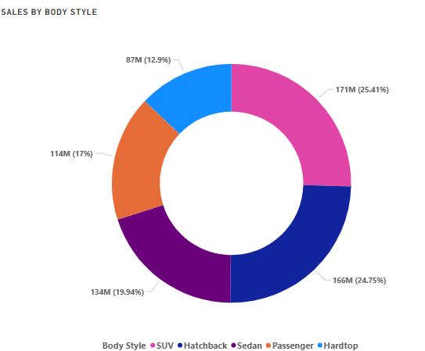
Sales by Body Style
Top Styles:
SUV
Hatchback
Insight: Focus inventory and marketing strategies on these styles to boost sales.

Slide 4
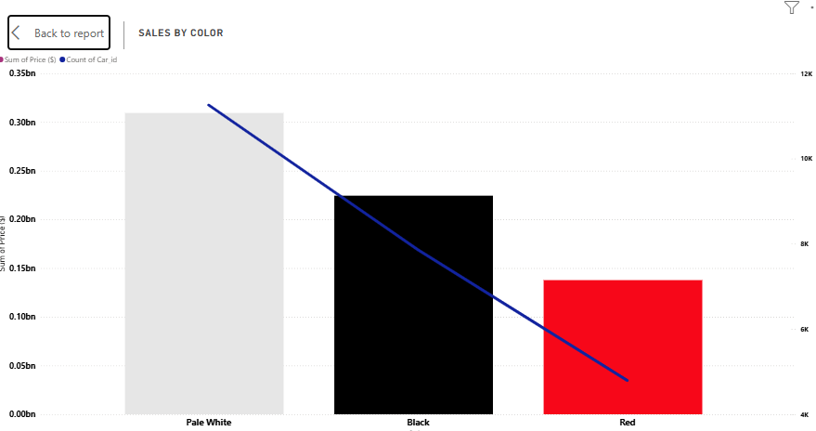
Sales by Color
Observation:
Most Preferred:Pale White
Least Preferred: Red
Insight: Inventory management can prioritize black vehicles; discounts may help move low-selling colors.

Slide 5
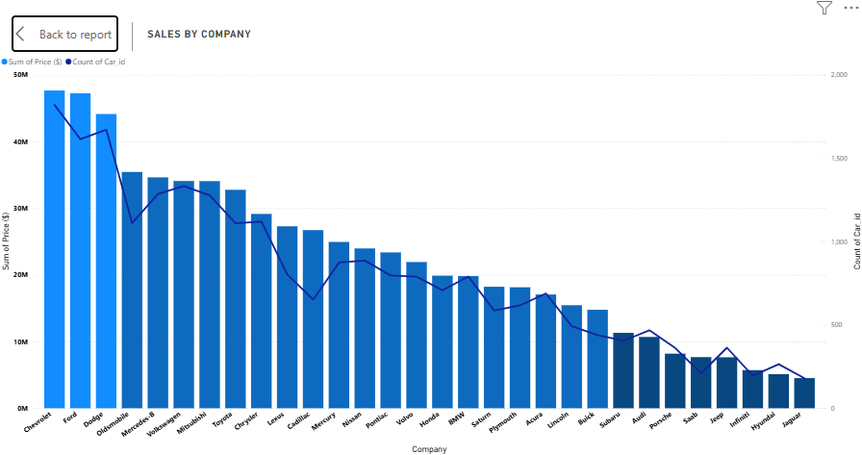
Sales by Company
Top Companies by Sales and Price:
Chevrolet
Ford
Dodge
Insight: Strong performance from leading brands. Consider strategic partnerships or expanded stock.

Slide 6
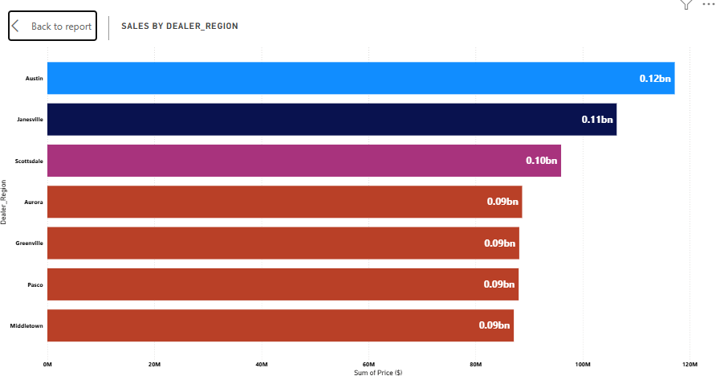
Sales by Dealer Region
Top Regions:
Austin
Janesville
Insight: These regions show highest revenue. Marketing budget should prioritize these areas.

Slide 7
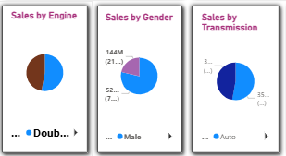
Sales by Engine / Gender / Transmission
Engine:
Almost Equal Sales in Double Â Overhead Camshaft and Overhead Camshaft
Gender:
Majority buyers: Male
Transmission:
Majority preference: Automatic
Insight: Improve gender-targeted marketing. Focus on stocking automatic cars.

Slide 8
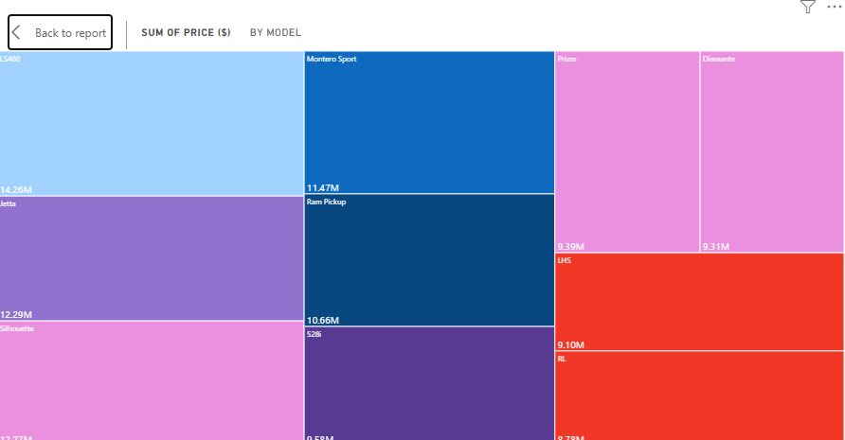
Sales by Model (Tree Map)
Top Models: LS400 Jetta Silhouette
Insight: Since LS400 and the other top models are customer favourites,Target lower models like RL,LHS to increase sales by providing discounts.

Slide 9
Dashboard Purpose
Purpose of This Dashboard:
To provide clear, visual insights into car sales performance across multiple categories.
To identify top-performing models, regions, and customer preferences.
To support data-driven decisions in marketing, inventory, and sales strategy.
To offer interactive filtering for flexible and deeper analysis.
End Goal: Empower business stakeholders with actionable insights to increase
sales efficiency and customer satisfaction.

